Slide 1

Global corruption analysis dashboard

Slide 2

GLOBAL corruption
Global Perception Corruption Index
Gender Gap in Education Opportunity
The International Poverty Line

Slide 3
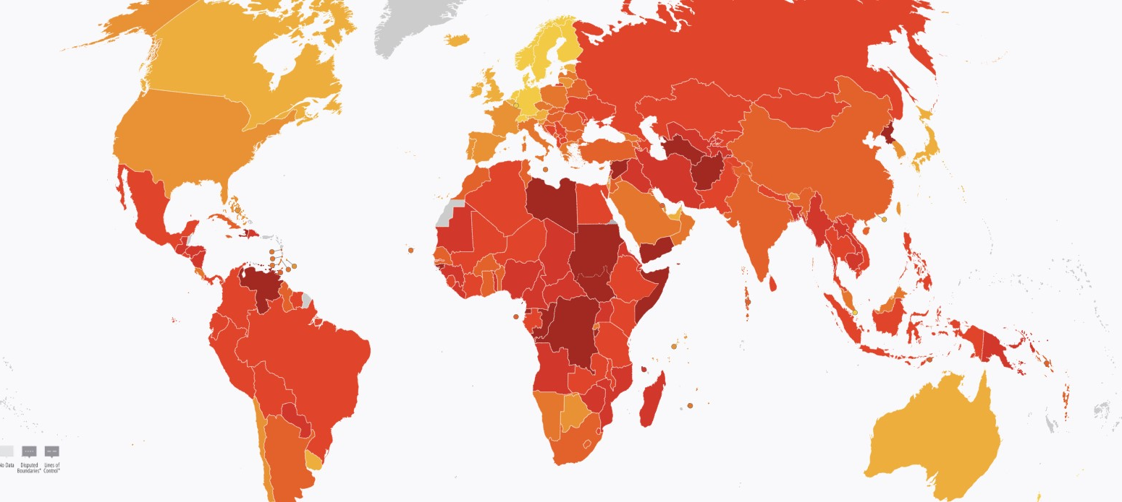
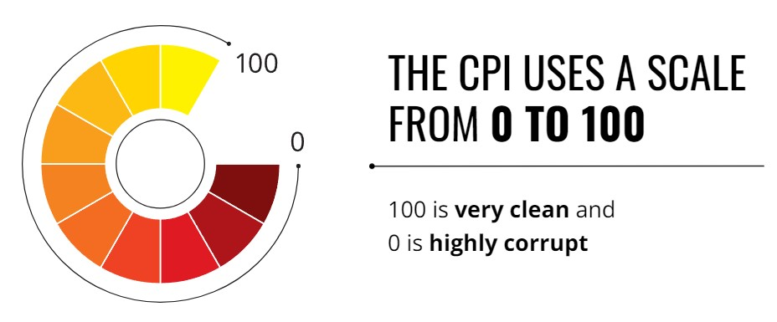
Global Corruption Perception Index 2020
Global world data bank
2020 was marked by the outbreak of a global pandemic that profoundly reshaped the world.
Over two-thirds countries score are below 50.
FOCUS - CPI source data capture diversion of public funds

Slide 4
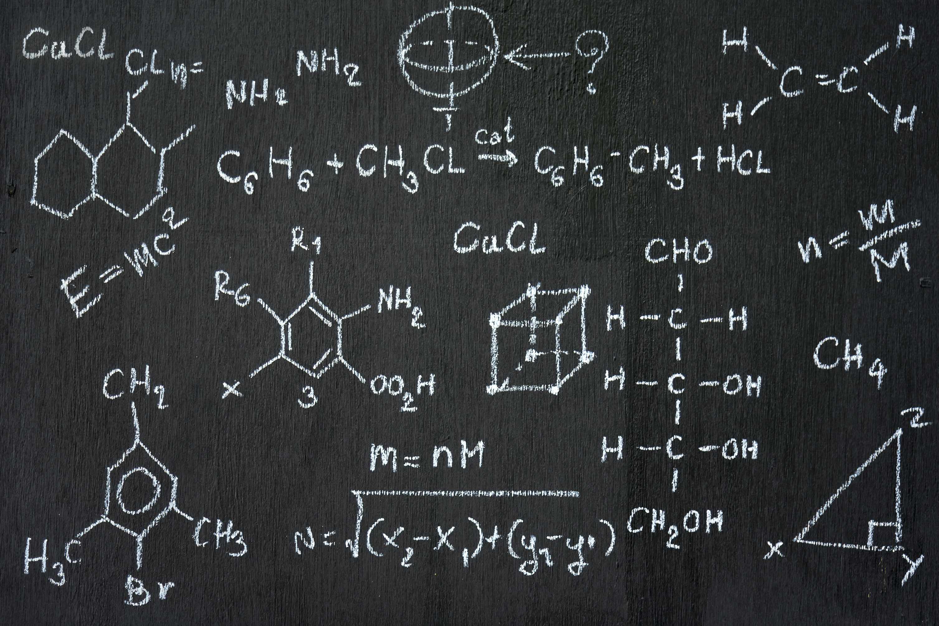

Education Opportunity
Public funds – education system
Tertiary Level – leads to higher paying career for both genders
Lack of public funds – lower quality of education levels, lower enrollment for both men and women.
Are both genders equally effected by the CPI?

Slide 5
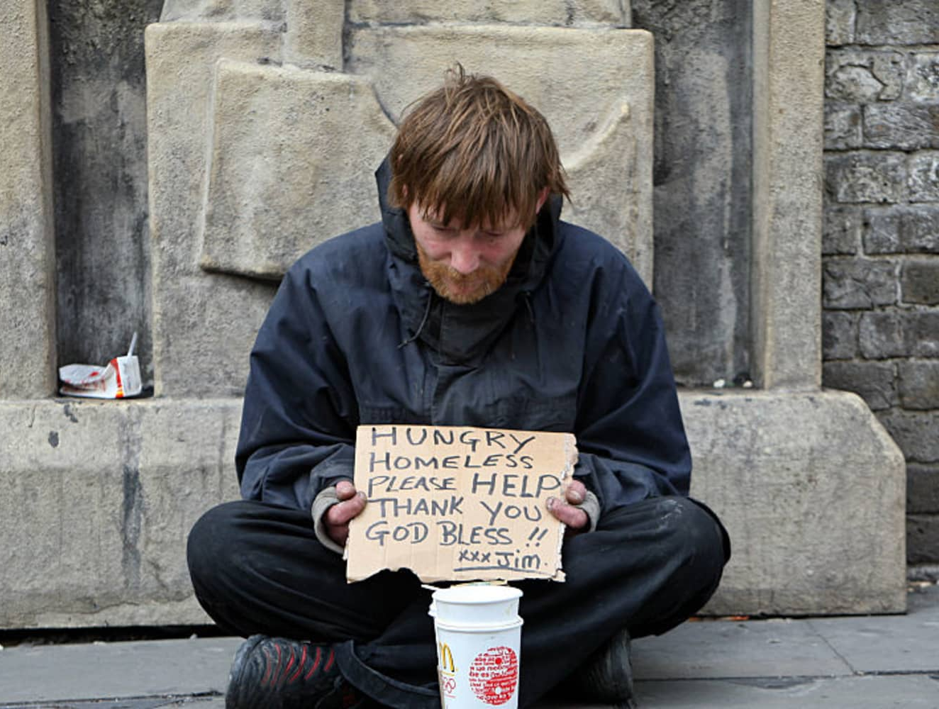
Global Poverty Line
Extreme poverty line < $2.15 p/day
Incorporates both monetary and non-monetary dimension of poverty
Non-monetary dimension indicators – education
Lack of education opportunity experience by people in poverty

Slide 6
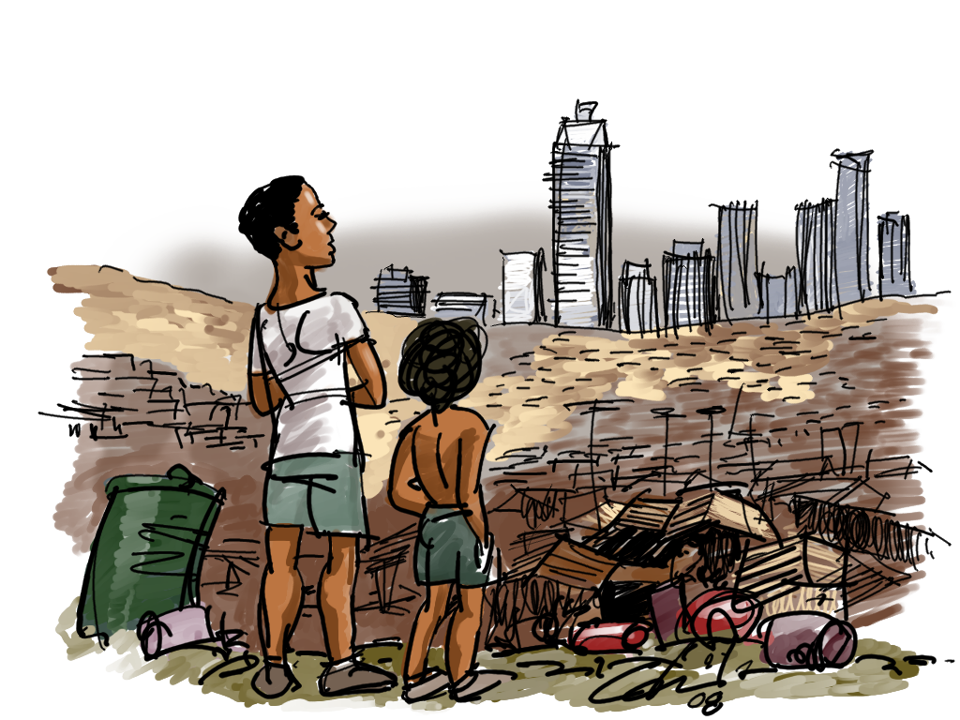
Exploring Correlations Between Corruption, Poverty, and Education Disparities
Global CPI – the more corrupt the country, the higher the gender gap disparity in terms of education enrollment
More corrupt country likely to sit on the poverty line < $2.15 p/day
Gross education enrollment are affected by countries sitting on the poverty line < $2.15 p/day
Male and female are affected differently in education level in poorer country

Slide 7
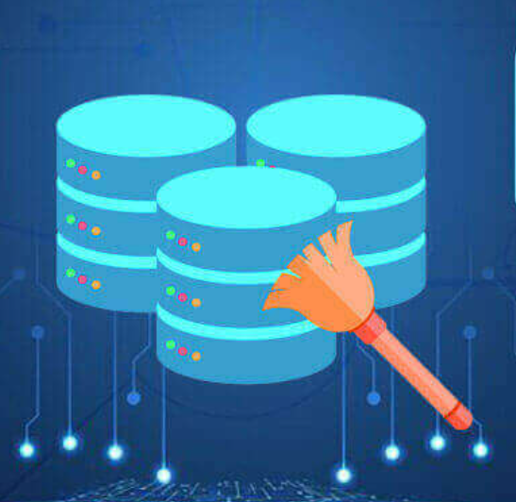
Data exploration, challenges & cleaning
Data exploration:
Criteria: Global poverty is a vast topic and most pressing challenges we face today, there are many reasons and varies across the nations around the world, considered the below data sets for the common reasons.
Corruption index score
Male & Female education enrolment percentage
Per capita income less below the International Poverty Line of $2.15 per day
Challenges:
Data across the datasets were not aligned, as the few country codes are different across the datasets, modified to have master data set which has unique values such as :
Country code
Country name
Region
Corruption index score
Corruption rank
Female enrolment percentage
Male enrolment percentage
Income less than $2.15 per day
Replaced the blank or Nan columns with zero as per capita income or female enrolment percentage or male enrolment percentage is not available across the data sets.
Cleaning:
Created master table world_poverty_data combining all the 3 data sets with the required columns in the Database(PGAdmin) and hosted the service through flask code in the Json format using jsonfiy route to get the Json data for world data visualization dashboard.
Data is filtered across the regions for better visibility in Bar chart and Doughnut charts, displaying corruption index score, Male & Female enrolment percentages and per capita income < $2.15 per day across the countries for the selected region.

Slide 8
WEB VISUALISATION
Heatmap: Corruption Perception Index
Visualizes corruption levels worldwide
Color-coded for quick assessment
Countdown Iframes: Awareness on Global Issues
Real-time statistics on critical global challenges
Embeds dynamic content within the page
Pie Chart: Regional Distribution
Breakdown of regions by the number of countries
Interactive for detailed exploration
Scatterplot: Income Poverty Line and Education Enrollment vs. Corruption Score
Compares male and female gross enrollment rates vs Corruption Scores
Compares Income poverty line vs Corruption Scores
Highlights the relationship with corruption perception
Resources: Libraries used
Bootstrap 5.3
Charts.js
Highcharts.js
Notes:
Our heatmap presents the Corruption Perception Index scores across countries. It’s color-coded: dark red indicating high corruption and green signaling lower levels. This visual tool allows for an immediate, intuitive grasp of global corruption patterns.
Embedded within our page is a countdown iframe. It ticks away critical stats: dwindling natural resources, growing population, and environmental deadlines. This iframe brings urgency to the global issues we face, emphasizing the need for timely action.
The pie chart represents the number of countries by region. It’s not just a static image; viewers can interact with it to gain specific insights into each region's composition, enhancing the user experience and understanding.
Our scatterplot is particularly telling. It juxtaposes the gross enrollment rates for males and females against corruption scores, illustrating a telling correlation between education and governance quality.
Every element of our dashboard has been designed with purpose. We chose the heatmap for its immediate visual impact, the iframe for dynamic content integration, the pie chart for its interactive data segmentation, and the scatterplot for its clear depiction of correlation.
By examining these visualizations, we aim to provide a platform for informed discussions and policy-making to tackle the pressing issue of poverty.

Slide 9
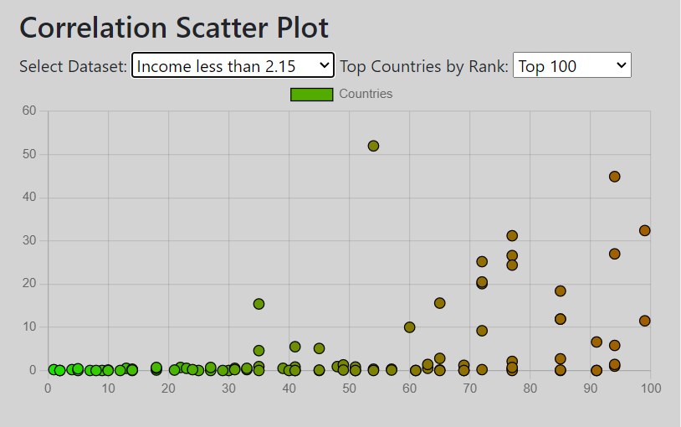
Insights, limitations, and conclusions
Insights
Significant correlation between corruption and poverty
Vague correlation between gender enrolment differences, and corruption and poverty
Limitations
Our zero values represents either 0% for the country or it represents that the country did not report their poverty levels
The ‘value’ of $2.15 changes over time
Corruption bias

